Slide 1
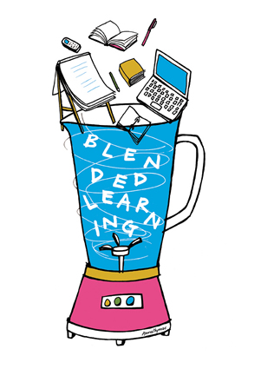
The Blended Learning Model
By Desiree Noland

Slide 2
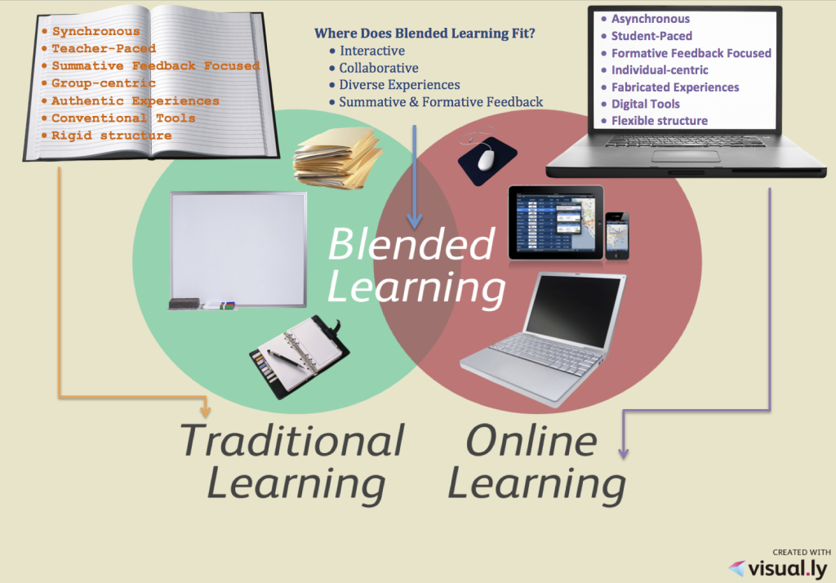
What is Blended Learning?
A mix of face-to-face and online learning
Lessons set to own pace
Increased opportunities to differentiate

Slide 3

Check Out This Video!

Slide 4
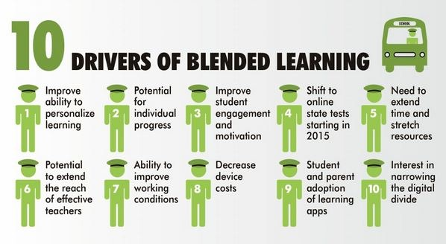
Why Blended Learning?

Slide 5

Tips to Use Blended Learning
According to Carol Tucker
Start Small
  There are tons of technologies and tools
  Choose one digital tool or technology to try when starting
  Become comfortable with one before going onto another
Mistakes Happen
  That is how you learn so don’t give up
  Ask students for help with technology-they have grown up with it!

Slide 6
Tips to Use Blended Learning
According to Carol Tucker
Use Technology To Make Life Easier
  Don’t just use it to use it
  Replace something with technology to make things easier, like a PowerPoint or EduCreations video for a lecture, or a wikipage for a class discussion
Truly Blend Technology
  Use it inside and outside the classroom
  Online Discussions-continue discussions on topics on sites like Uclass
  Expert Group Investigations-students in small groups research a topic online and present using digital tools

Slide 7
Tips to Use Blended Learning
According to Carol Tucker
Everyone Can Get Online
  Even if they don’t have internet at home, there is access in the community
  Town libraries, school libraries, computer labs
  Internet is important and part of Common Core-students need to have access
  Explain to parents at Back to School Night the importance
  In class, work in groups or rotate if not enough computers/tablets

Slide 8

A Vision of K-12 Students Today
Click Image Below

Slide 9
How Do I Blend My Learning?
Blogs, Wikis and online Discussion Formats
  Students can post and answer questions on these platforms to expand on topics in class
  Uclass.org
  Educational Wikispaces
Webquests
  Guide students through a research project
  Many pre-made webquests online
  One I made on New Jersey
  Collection of webquests by Kathi Mitchell

Slide 10
How Do I Blend My Learning?
Digital Storytelling
  Using PhotoStory3 for PC or iMovie on the iPad
  An example using the iPad for Cyberbullying
  An example with PhotoStory3
Flipped Classrooms
  Students complete the learning/lecture part outside the classroom and apply the knowledge in the classroom
  Video on Flipped Learning
  Here is an example with Geometry-Educreations on the iPad was used to create the video

Slide 11
How Do I Blend My Learning
Models: Simulations and Mind tools
  Simulations are interactive technologies where students can move and change components without risk of messing something up or getting hurt
  Mind tools allow students to show concepts they learn
  Here is an example lesson using both
  Additional simulations for the classroom

Slide 12
Is That All?
NO WAY! There are so many ways to use technology in the classroom to expand students’ learning. They love technology and it really differentiates learning.
“Blended learning offers improved pedagogy, increased access to knowledge, and fostered social interaction between learners. Easy use of multiple modalities in blended learning approach provides better support for different learning styles among students”
(Ayala 2009; Osguthorpe and Graham, 2003, as cited by Uzun & Senturk, 2010).

Slide 13

Our students are our future. We need to prepare them to adapt and apply the skills they are learning to the tools they will be using.

Slide 14
References
Abud, G. G. [Blended Learning Infographic]. Retrieved from http://abud.me/does-blended-learning-
have-a-place-in-the-classroom-infographic/
Appelo, J. (2013). [YouTube Logo]. Retrieved from http://www.noop.nl/
Carly (2013, February 21). Infographic: How to implement bended learning [Inforgraphic]. Retrieved
from http://blogs.terrapinn.com/total-learning/2013/02/21/infographic-implement-blended-
learning/
Cobb, K. (2013, January 29). What is blended learning? [Video file]. Retrieved from
http://www.youtube.com/watch?v=uOUrWn8GSvw
Cooper, A. (2013, July 27). [Blended Learning Image]. Retrieved from
http://freshmancomp.com/category/blended-learning/
The Learning Accelerator (2013, August 14). [Learners Today Graphic]. Retrieved from
http://learningaccelerator.org/blog/2013/8/announcing-first-district-wide-blended-learning-
partnership-with-reynoldsburg-city-schools
Nesbitt, B. (2007, November 28). A Vision of K-12 Students Today [Video file]. Retrieved from
http://www.youtube.com/watch?v=_A-ZVCjfWf8&feature=youtu.be
Tucker, C. (2013, March). The basics of blended instruction. Educational Leadership, 57-60.
Uzun, A., & Senturk, A. (2010). Blending makes the difference: Comparison of blended and traditional instruction
on students' performance and attitudes in computer literacy. Contemporary Educational Technology, 1(3),
196-207.
Wolpert-Gawron, H. (2011, April 28). Blended Learning: Combining Face-to-Face and Online Education |
Edutopia. Retrieved November 15, 2013, from http://www.edutopia.org/blog/blended-online-learning-
heather-wolpert-gawron

